Slide 1
Missing the Forest
the Trees
for
When Server Hardening Isn’t Enough
@HomeBrewedSec
#MissForest4Trees

Slide 2
Audience Participation
I won’t be having a Q&A time (use the hashtag)
Q&A usually isn’t inclusive for speaker or participant
If I use an acronym or concept you don’t understand:
Tweet me (hashtag or @)
Heckle. Yell out “ELABORATE” or “EXPLAIN YOURSELF”
# MissForest4Trees

Slide 3
Goals
Show Red Teamers Blue Team Concepts
Show Blue Teamers Red Team Concepts
Demonstrate how NOT to Threat Model
Help you convince management
Make your job easier
# MissForest4Trees
Notes:
I’ll go through this very quickly, as it is quite literally not the point of this talk at all

Slide 4
Hardening Basics
Principal of Least Privilege: An account shouldn’t be able to access anything that account shouldn’t have access to
Principal of Least Functionality: A machine shouldn’t be able to do anything that machine shouldn’t be able to do
Encrypt all the things & Patch all the things
# MissForest4Trees

Slide 5
Is that Enough? (No it isn’t)

Slide 6
Quick Caveat
There are many other things needed than server hardening (duh)
I’m not talking about all of those things (duh)
I’m talking about commonly overlooked hypervisor misconfigurations as an example for threat modeling
I’m going to use Active Directory as my target box to “pop”, these lessons apply to other things
# MissForest4Trees

Slide 7
Threat Modeling
Know what you’re protecting and know what you’re protecting against
Defender’s Dilemma (traditionally): An attacker only needs to exploit one weakness, a defender needs to protect all weaknesses
Attacker’s Dilemma (homebrewedsec): A defender needs to make it too expensive for an attacker to exploit a target given the value of that target
# MissForest4Trees

Slide 8
Red Team Demo

Slide 9
Notes:
Finding Nutanix, Finding ESX

Slide 10
Notes:
Logging in to found ESX host

Slide 11
Notes:
Resetting AD DSR Password

Slide 12
Notes:
Logging in to AD DSRM Mode

Slide 13
Notes:
Grabbing ntds

Slide 14
Notes:
Drop hashes-impacket

Slide 15
Notes:
John the ripper

Slide 16
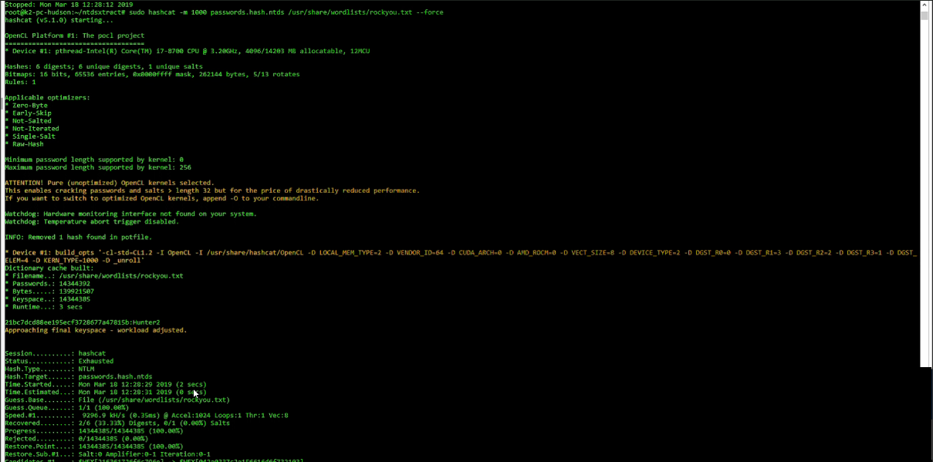
Notes:
John the ripper

Slide 17
Lessons Learned (red)
Consider your hypervisor administrators as administrators on every guest VM they can access
Change default passwords
Segment your networks
Monitor privileged accounts
Upgrade OSes
# MissForest4Trees

Slide 18
Blue Team Demo

Slide 19
DC Last Restart
Import-Module ActiveDirectory
$DomainControllers=Get-ADComputer –searchbase"ou=domain controllers,dc=corp,dc=local" -filter *
$YDay=(get-date).AddDays(-1)
$recipients = @("Hudson Bush <Hudson.bush@k2si.net>“)
$message=@()
foreach ($DomainController in $DomainControllers){
$LastBootUpTime=Get-WmiObject Win32_OperatingSystem –ComputerName $DomainController
if ($LastBootUpTime.LastBootUpTime -gt $YDay) {
$message+=$DomainController
}
}
if ($message -gt 0){
Send-MailMessage -To $recipients -From “IT.Notifications@corp.local" -Subject “Domain Controller Restart"
-bodyashtml $message -smtpserver mail.corp.local
}

Slide 20
Check AD Group Change
Import-Module ActiveDirectory
$PrivGroups=@("Domain Admins","Enterprise Admins","Schema
Admins","Organization Management","DNSAdmins","Account
Operators","Cert Publishers")
$YDay=(get-date).AddDays(-1)
$recipients = @("Hudson Bush <Hudson.bush@k2si.net>“)
$message=@()
foreach ($PrivGroup in $PrivGroups){
Get-ADGroup $PrivGroup -properties Modified |where
{$_.Modified -gt $Yday}|select name
}
if ($message -gt 0){
Send-MailMessage -To $recipients -From “IT.Notifications@corp.local" -Subject “AD Group Membership Changed“
-bodyashtml $message -smtpserver mail.corp.local
}

Slide 21
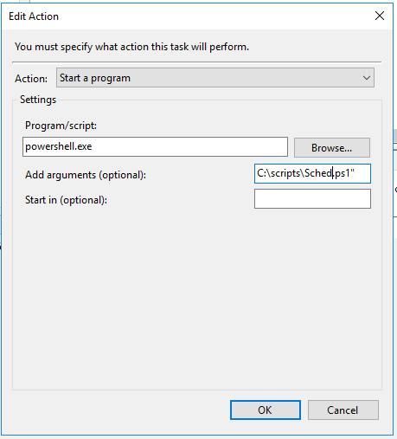
PowerShell Scheduled Task

Slide 22
Lessons Learned (blue)
You don’t need Product X to do monitoring
You do need monitoring
PowerShell is awesome
Automate reporting
Consider automating defense actions (carefully)
# MissForest4Trees

Slide 23
We’re Almost Done (breathe)

Slide 24
Tl;dr
Don’t focus on the trendy exploit-of-the-day
Think “what is the easiest way an attacker could exploit fillintheblank?”
Protecting against fillintheblank is usually easier than protecting against exploit-of-the-day
Focus on the difficult only once it’s difficult to do the easy thing
# MissForest4Trees

Slide 25
Appendix: Resources
AD Hardening (@derekmelber)
https://www.rsaconference.com/writable/presentations/file_upload/crwd-r04-top-10-security-hardening-settings-for-windows-servers-and-active-directory.pdf
Installing Kali on Windows Subsystem for Linux
https://www.kali.org/news/kali-linux-in-the-windows-app-store/
Offline Windows Password and Registry Editor
https://pogostick.net/~pnh/ntpasswd/
Building a mobile pentesting box (@dalemeredith)
https://www.daledumbsitdown.com/what-is-the-batpi/
Auditing Active Directory Passwords (@ropnop)
https://blog.ropnop.com/extracting-hashes-and-domain-info-from-ntds-dit
Cover Photo
https://images.unsplash.com/photo-1477696957384-3b1d731c4cff?ixlib=rb-1.2.1&ixid=eyJhcHBfaWQiOjEyMDd9&auto=format&fit=crop&w=500&q=60

Slide 26
Missing the Forest
the Trees
for
When Server Hardening Isn’t Enough
Slides
homebrewedsec.com/talks/
Questions
@HomeBrewedSec
#MissForest4Trees

